Slide 1
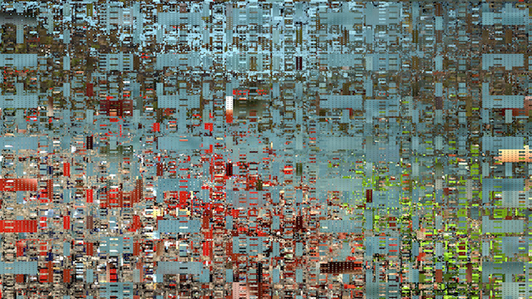
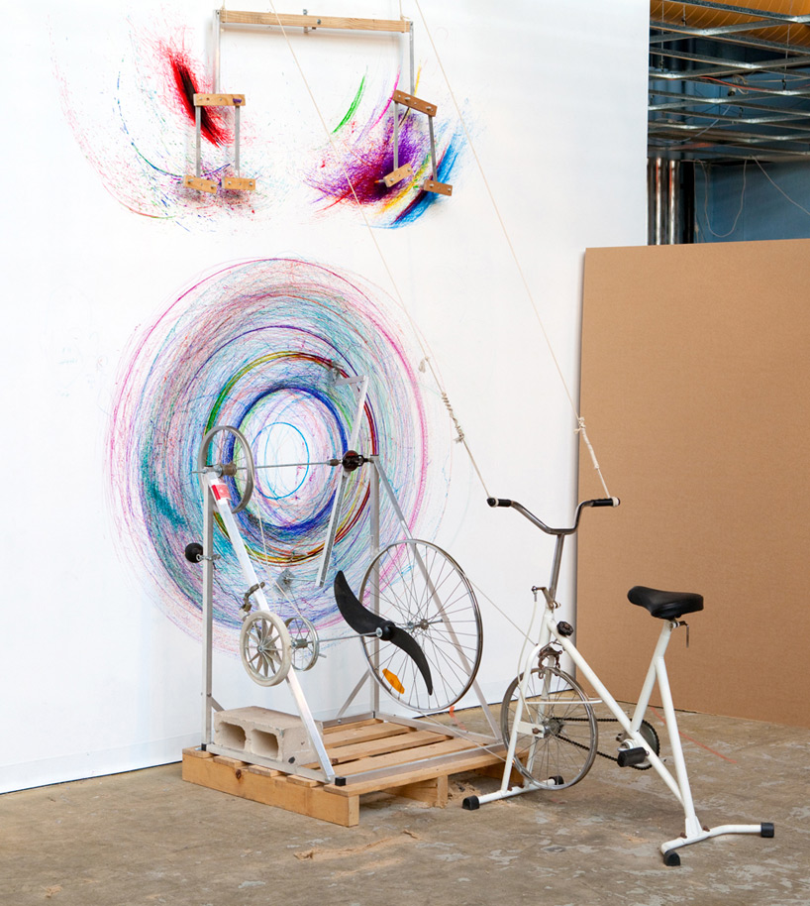
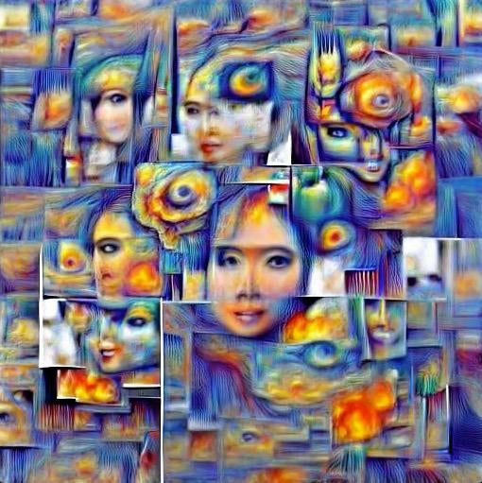
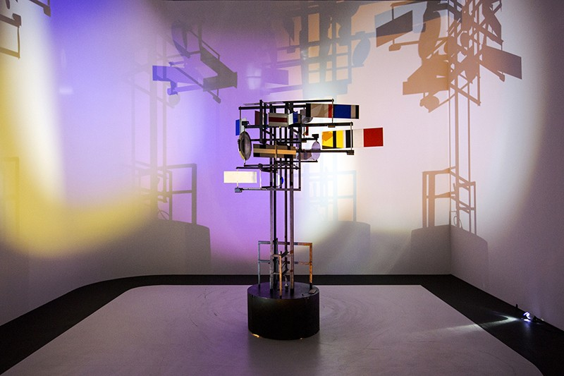
STA 491: Poetic Computation
Fall 2021

Slide 2
Agenda
Welcome!
Introductions
What is Poetic Computation?
Class & Syllabus Review
Create WordPress Account
Complete In-class Exercise 0
Intro to p5.js

Slide 3
#aboutme
Abhishek Narula
Assistant Professor – Electronic Art & Intermedia / XA
machine & computational aesthetic
sculpture & installation
U of M – MFA
Georgia Tech – MS & BS Electrical Engineering

Slide 4
Introductions
Name / Preferred pronoun
Major / Year
Describe your creative practice?
Why are you here? / What do you hope to get out of this class?
What is your experience with programming or electronics?
What is your experience with building stuff?

Slide 5
What is
Poetic Computation?

Slide 6
What is
Computation
a Computer?

Slide 7
What is Computation a Computer?
Software
Hardware

Slide 8
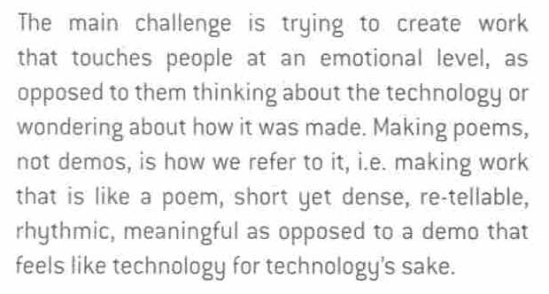
-- Zachary Lieberman, in iDN

Slide 9
The goal of this class is…
To make art & design experiences/objects that engages with culture in thoughtful and provocative ways.
To use software and electronics as a ‘medium’
To learn and approach our medium as crafting materials to execute our ideas.

Slide 10
Technical Platforms
p5.js – JavaScript Visual programming language
Processing – Java Visual programming language
Arduino – Hardware programming

Slide 11
Themes
Generativity. Meta-creation and infinite variation. Things that make things.
Immersivity & Interactivity. We will see different forms of immersion and systems that respond in a unique, open-ended, and tightly coupled way to the actions of its participant .
Transmediality. The transformation and transmutation of signals; information visualization and sonification. Revealing new truths.
Artificial Life. The illusion of life.

Slide 12
Class Structure
Studio Art Course
MW 11:30 – 2:20 pm
Lecture/Tech Demos/Presentations ~ 60 mins
Break ~ 20/30 mins
Studio Work ~ 60/90 mins
Kresge Art Center Room 5
Card Access Form – I will email you
Class website: https://sta491pc.com/

Slide 13
COVID STATEMENT

Slide 14
Syllabus Review

Slide 15
What you should expect from me...
Clear and frequent communication
Clear requirements of each assignment/project
Enthusiasm to teach/learn in every class
Updated Website
Resource for both technical and creative questions

Slide 16
What I should expect from you...
Clear and frequent communication
Enthusiasm to teach/learn in every class
Keep track all deadlines
Planning for projects
Practice, Practice & Practice
Be brave….

Slide 17
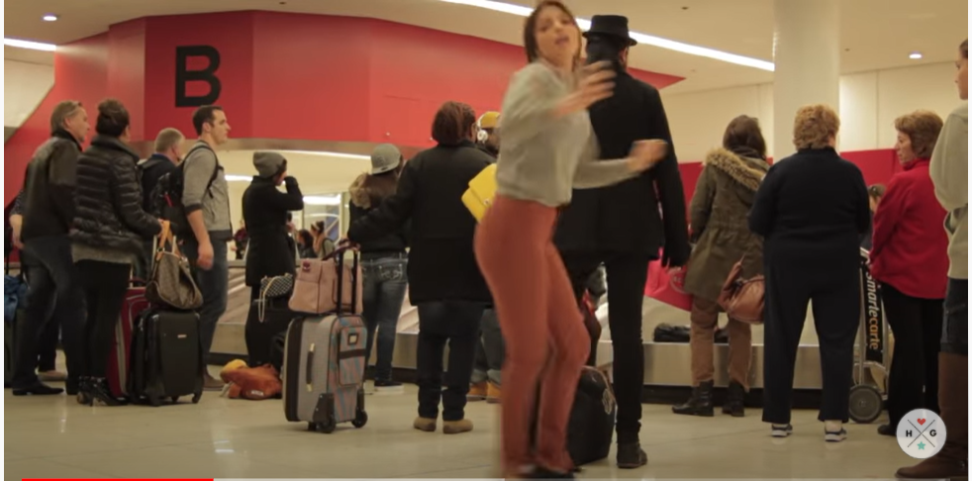
Be Brave!
https://www.youtube.com/watch?v=S32bgx36G-0

Slide 18
Create WordPress Account
Send me your username so I can add you to the class website

Slide 19
A peek at p5.js

